Slide 1

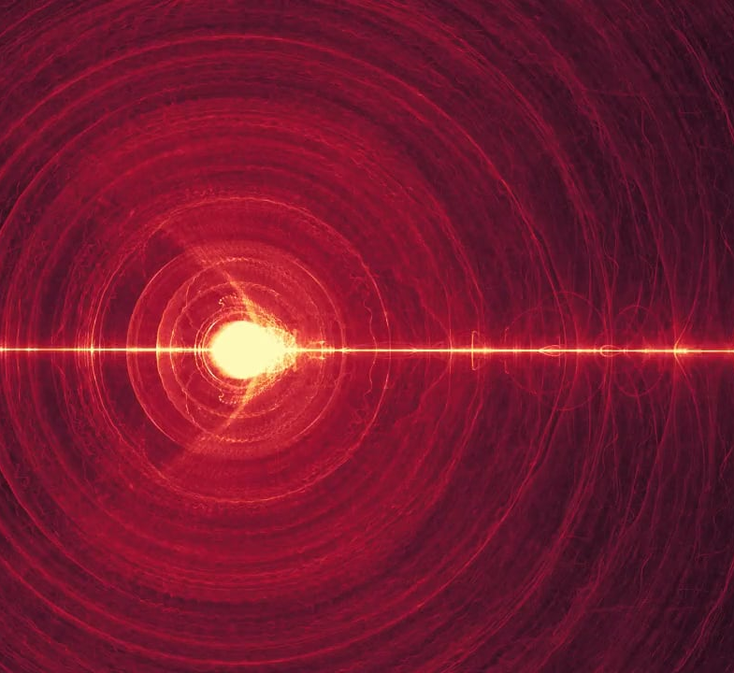
SPSM 5065 RADIATION ENVIRONMENT
Single Event Phenomena
Solar Radiation Pressure

Slide 2
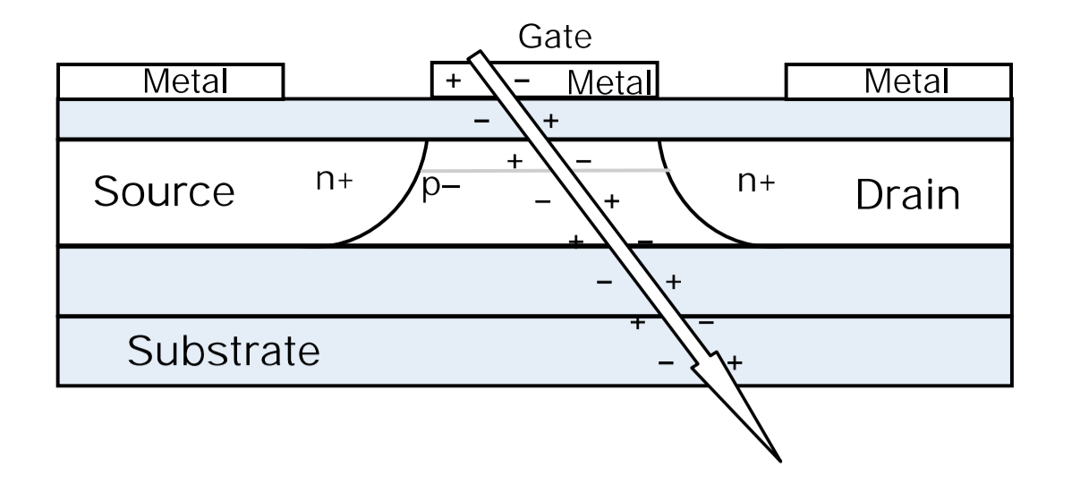
SINGLE EVENT PHENOMENA
SEU – upset, reversible
Burnout – permanent damage

Slide 3
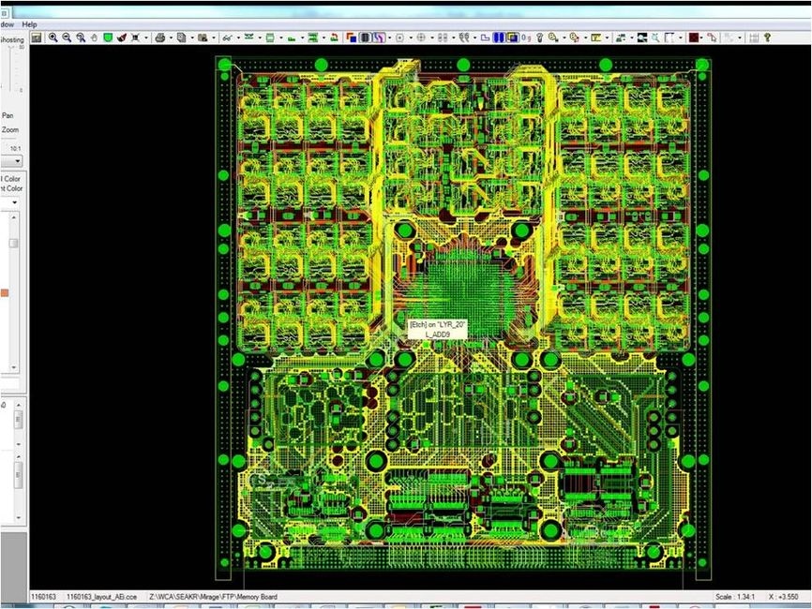
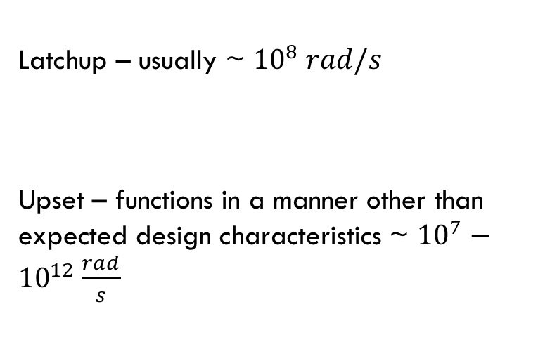
SINGLE EVENT PHENOMENA
Latchup – usually ~ ${10}^{8} rad/s$
Upset – functions in a manner other than expected design characteristics ~ ${10}^{7}−{10}^{12}\frac{rad}{s}$

Slide 4
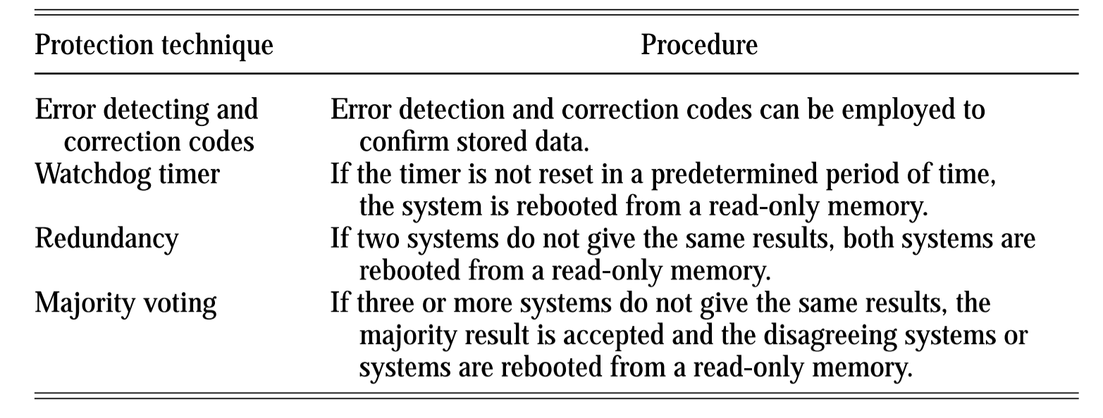
SINGLE EVENT PHENOMENA mitigation strategies

Slide 5
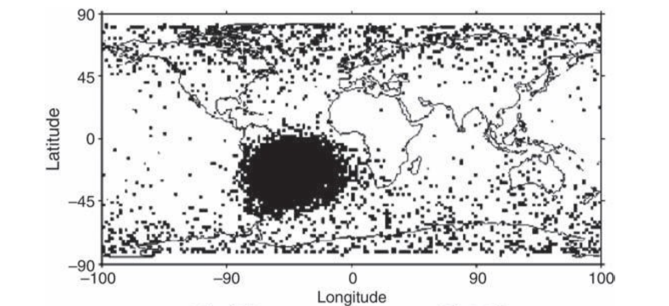

Slide 6
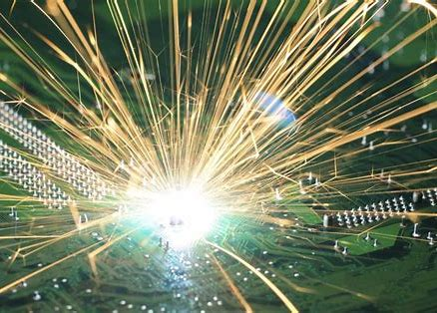
Other single event phenomena
SET – Single event transient
SEFI – Single Effect Functional Interrupt
SEGR – Single event gate rupture

Slide 7
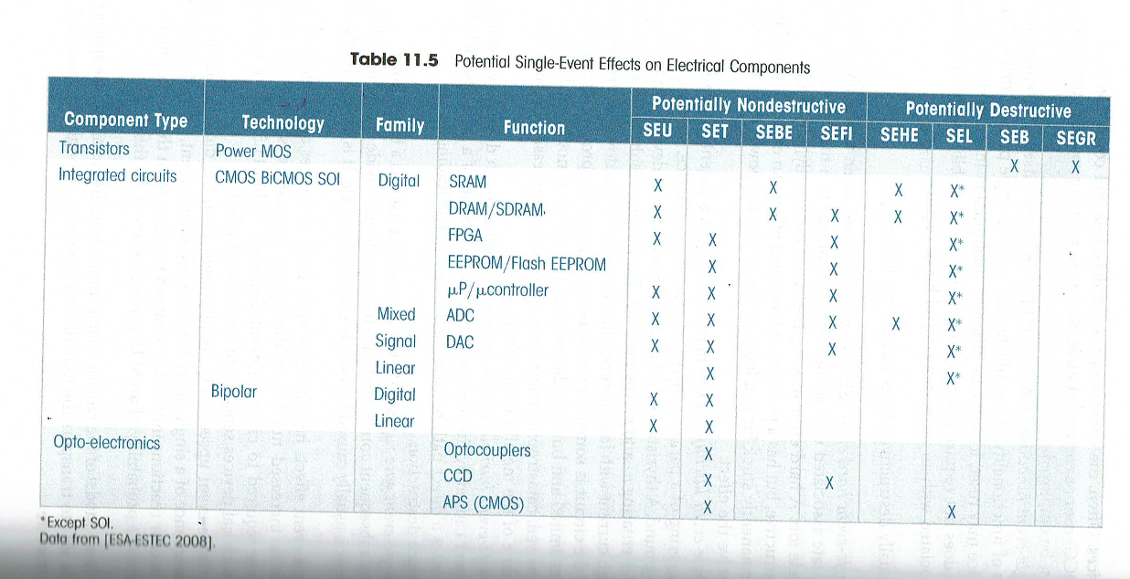
Potential seP on electrical components

Slide 8
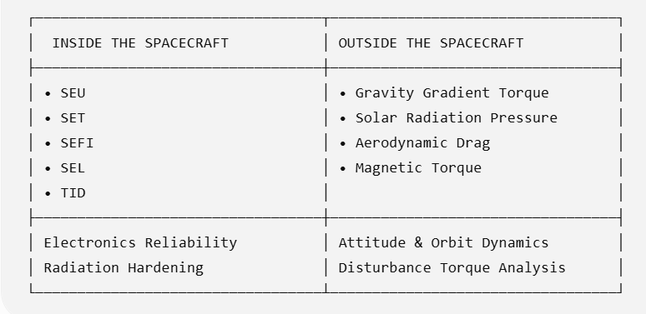
HOW THE RADIATION ENVIRONMENT AFFECTS SPACECRAFT

Slide 9
Effects of on-orbit disturbances

Slide 10

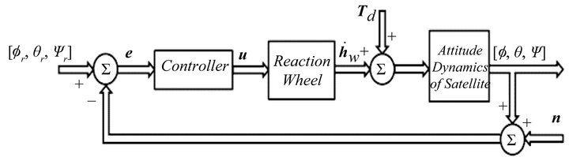

REACTION WHEEL SIZING
$$T_{D}=Disturbance Torque= ?$$

Slide 11
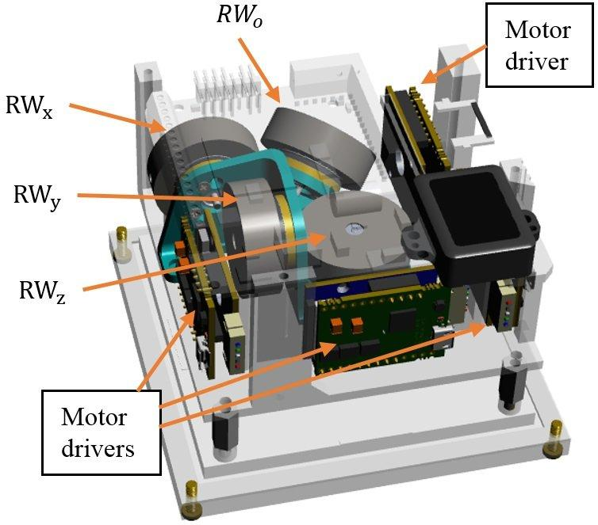
REACTION AND MOMENTUM WHEEL SIZING
 | Torque | Mass | Power
Small sats | <0.05 N-m | 5 kg/wheel | 10 W
Mid size | 0.05 – 0.15 N-m | 16.5 kg/wheel | 35 W
Large sats | > 0.15 N-m | 25 kg/wheel | 100 W

Slide 12
Impact of the Space Environment on Spacecraft Systems
Space Environments
Vacuum | Neutral | Plasma | Radiation | MM/OD
Spacecraft Subsystems | Solar UV | Outgassing/ Contamination | Aerodynamic Drag | Sputtering | Atomic Oxygen | Spacecraft Glow | Spacecraft Charging | Van Allen Belts | Galactic Cosmic Rays | Solar Proton Events | Impacts
Attitude Determination & Control |  | Degradation of sensors | Induced torques |  |  | Interference with sensors | Torques due to induced potentials
Avionics |  |  |  |  |  |  | Upsets due to EMI from arcing |  |  |  | EMI due to impacts
Electrical Power |  |  |  |  |  |  | Shift in floating potential, reattraction of contaminants |  |  |  | Destruction/ obscuration of solar cells
Propulsion |  | Thruster plumes may be a contaminant source | Drag makeup fuel requirement |  |  |  | Shift in floating potential due to thruster firings |  |  |  | Rupture of pressurized tanks
Structures |  |  |  |  |  |  |  |  |  |  | Penetration
Telemetry, Tracking & Communications |  | Degradation of sensors |  |  |  | Interference with sensors | EMI due to arcing |  |  |  | EMI due to impacts
Thermal Control |  |  |  |  |  |  | Reattraction of comtaminants |  |  |  | Degradation of alpha/epsilon
Change in sensor coatings
Degradation: SEUs, bit errors, …
Change in coverslide transmittance
Change in coverslide transmittance
Degradation of solar cell output
Change in sensor coatings
Degradation of electronics
Change in surface alpha/epsilon ratio
Change in surface alpha/epsilon ratio
Cold surfaces may experience heating
TSE, Fig 7.1
Notes:
A variety of environmental effects have a direct impact on the ability of spacecraft subsystems to execute their design objectives
This chart provides a good summary of the impacts of the space environment on these subsystems
⇒ we’ll walk through each of these areas in the next several slides
Must recognize that extra margin must be designed into spacecraft subsystems to handle these impacts

Slide 13
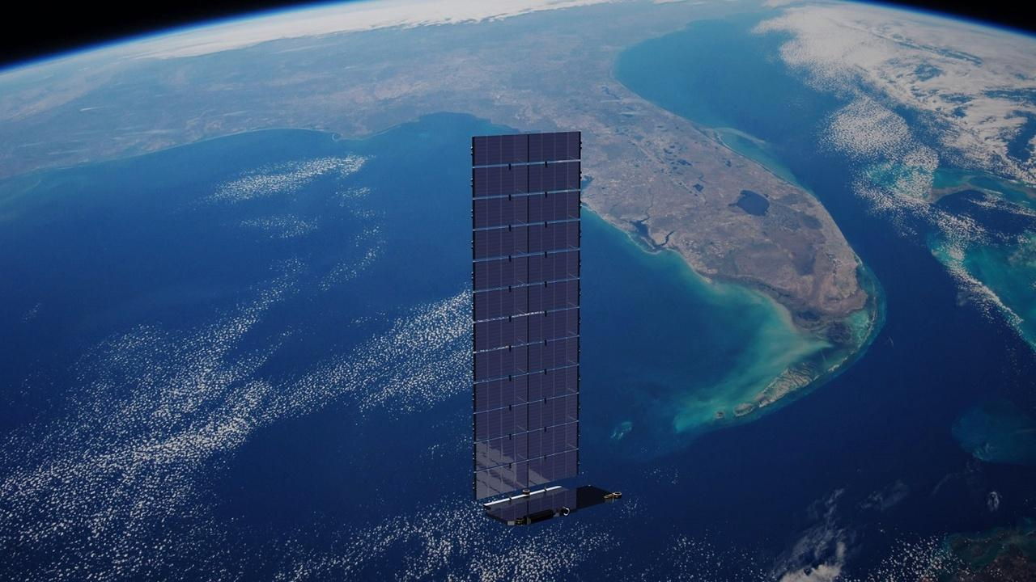
EXAMPLE – HW PROBLEM 4
6. (20 pts.) Estimate the solar radiation disturbance torque on a Starlink Satellite. The spacecraft body is 3.2 x 1.6 x 1.2 m³ and has a mass of 30 kg. The Solar array is 3.2 x 10.9 m² with a mass of 197 kg and they are sun-tracking. You may assume it is in an orbit such that it is facing the sun at all times. A Space X artist’s rendering may be seen in Figure 5 [6].
a. Find the SRP force on the satellite. Assume a center of pressure of 6.03 m.
b. What size and power would you recommend for the satellite’s momentum wheels? Be sure to include a margin factor when sizing your RWs.
Figure 5: Starlink satellite in low Earth orbit with its single deployable solar array. Image credit: SpaceX.

Slide 14
EXAMPLE – HW PROBLEM 4
6. (20 pts.) Estimate the solar radiation disturbance torque on a Starlink Satellite. The spacecraft body is 3.2 x 1.6 x 1.2 m³ and has a mass of 30 kg. The Solar array is 3.2 x 10.9 m² with a mass of 197 kg and they are sun-tracking. You may assume it is in an orbit such that it is facing the sun at all times. A Space X artist’s rendering may be seen in Figure 5 [6].
a. Find the SRP force on the satellite. Assume a center of pressure of 6.03 m.
b. What size and power would you recommend for the satellite’s momentum wheels? Be sure to include a margin factor when sizing your RWs.

Slide 15
REFERENCES
Carranza, O., et al. "A Total Energy Attitude Control System Strategy for Rigid Spacecraft." IEEE Access, 2019. Slide 11.
SpaceX, Starlink V2 Mini Satellite Rendering, SpaceX Media Resources, Hawthorne, CA, 2023. Available: https://www.spacex.com/updates/ Slide 13.

